Slide 1
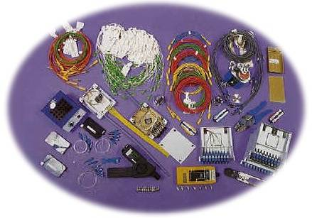


Slide 2

is a method of transmitting information from one place to another by sending light through an optical fiber.
The light forms an electromagnetic carrier wave that is modulated to carry information.

Slide 3
The process of communicating using fiber-optics involves the following basic steps:
Creating the optical signal using a transmitter,
relaying the signal along the fiber, ensuring that the signal does not become too distorted or weak,
and receiving the optical signal and converting it into an electrical signal.

Slide 4

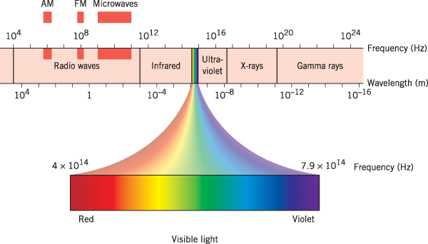
Electromagnetic Spectrum

Slide 5

1880 – Alexander Graham Bell
1930 – Patents on tubing
1950 – Patent for two-layer glass wave-guide
1960 – Laser first used as light source
1965 – High loss of light discovered
1970s – Refining of manufacturing process
1980s – OF technology becomes backbone of long distance telephone networks in NA.

Slide 6

An optical fiber (or fibre) is a glass or plastic fiber that carries light along its length.
Light is kept in the "core" of the optical fiber by total internal reflection.

Slide 7

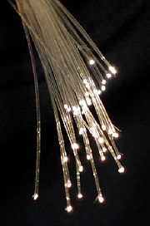
Thinner
Less Expensive
Higher Carrying Capacity
Less Signal Degradation& Digital Signals
Light Signals
Non-Flammable
Light Weight

Slide 8

Much Higher Bandwidth (Gbps) - Thousands of channels can be multiplexed together over one strand of fiber
Immunity to Noise - Immune to electromagnetic interference (EMI).
Safety - Doesn’t transmit electrical signals, making it safe in environments like a gas pipeline.
High Security - Impossible to “tap into.”

Slide 9

Less Loss - Repeaters can be spaced 75 miles apart (fibers can be made to have only 0.2 dB/km of attenuation)
Reliability - More resilient than copper in extreme environmental conditions.
Size - Lighter and more compact than copper.
Flexibility - Unlike impure, brittle glass, fiber is physically very flexible.

Slide 10

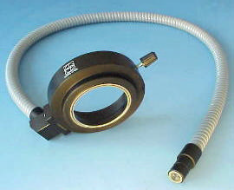
greater capacity (bandwidth up to 2 Gbps, or more)
smaller size and lighter weight
lower attenuation
immunity to environmental interference
highly secure due to tap difficulty and lack of signal radiation

Slide 11

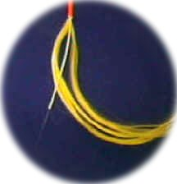
Disadvantages include the cost of interfacing equipment necessary to convert electrical signals to optical signals. (optical transmitters, receivers) Splicing fiber optic cable is also more difficult.

Slide 12

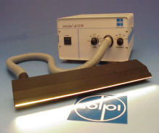
expensive over short distance
requires highly skilled installers
adding additional nodes is difficult

Slide 13

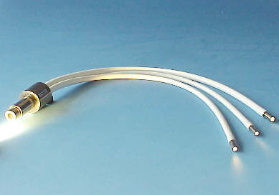
Telecommunications
Local Area Networks
Cable TV
CCTV
Optical Fiber Sensors

Slide 14

relatively new transmission medium used by telephone companies in place of long-distance trunk lines
also used by private companies in implementing local data networks
require a light source with injection laser diode (ILD) or light-emitting diodes (LED)
fiber to the desktop in the future

Slide 15

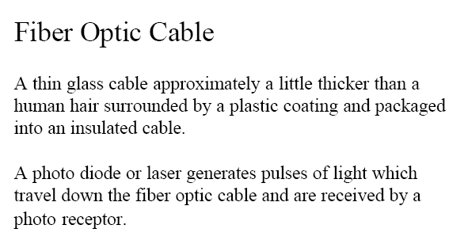


Slide 16
Optical fiber consists of a core, cladding, and a protective outer coating, which guides light along the core by total internal reflection.

Slide 17

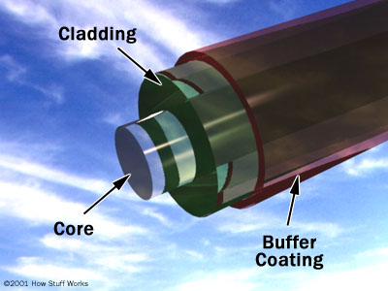
Core – thin glass center of the fiber where light travels.
Cladding – outer optical material surrounding the core
Buffer Coating – plastic
coating that protects
the fiber.

Slide 18
The core, and the lower-refractive-index cladding, are typically made of high-quality silica glass, though they can both be made of plastic as well.

Slide 19

consists of three concentric sections
plastic jacket
glass or plastic
cladding
fiber core

Slide 20

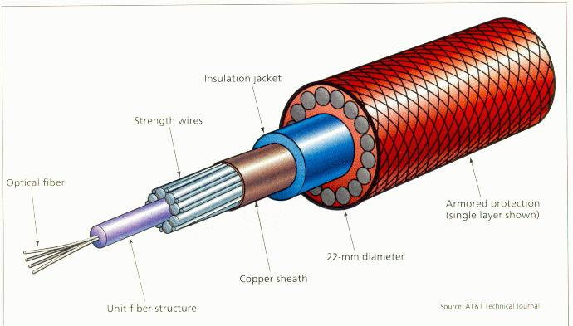

Slide 21

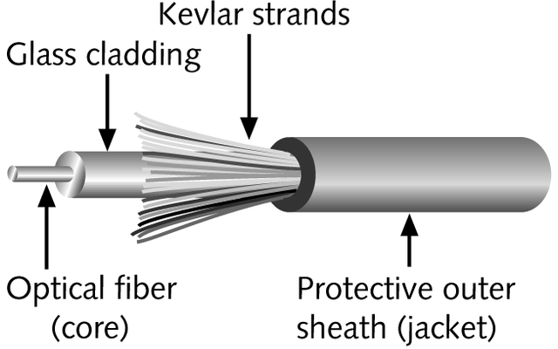
Contains one or several glass fibers at its core
  Surrounding the fibers is a layer of glass called cladding

Slide 22

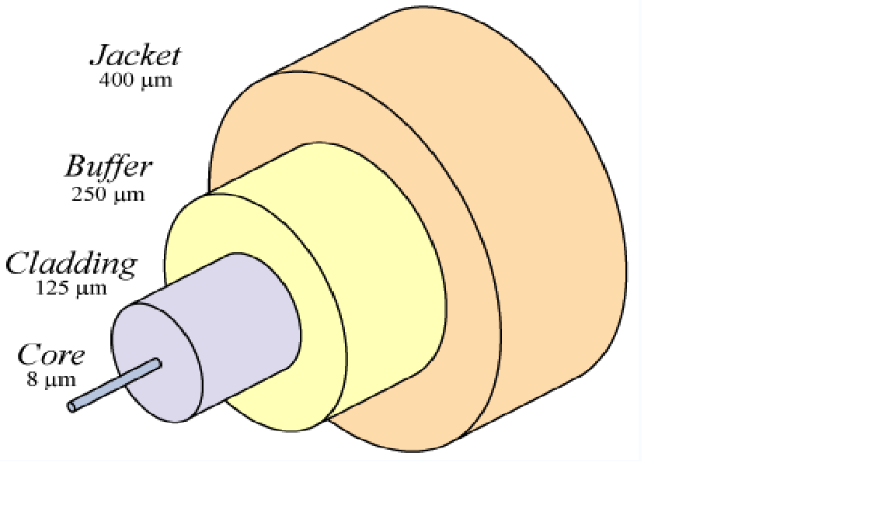
3 TYPES OF OPTICAL FIBERS
Plastic core and cladding
Glass core with plastic cladding ( called PCS fiber- Plastic Clad Silica )
Glass core and glass cladding ( called SCS - Silica Clad Silica )

Slide 23

Photons (light “particles”)
light represented by tiny bundles of energy (or quanta), following straight line paths along the rays.

Slide 24
PLANCK’S LAW
Ep =hf
Where,
Ep – energy of the photon (joules)
h = Planck’s constant = 6.625 x 10 ⁻³⁴ J-s
f – frequency o f light (photon) emitted (hertz)

Slide 25

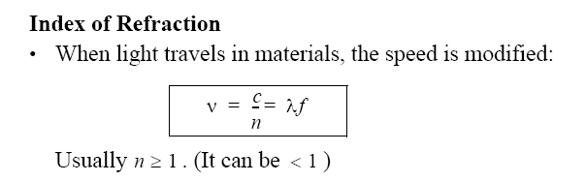

Slide 26

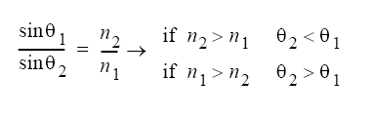

Slide 27
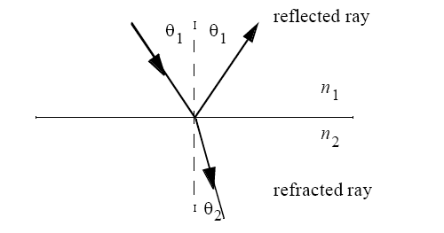

Slide 28

Let medium 1 be glass ( n1 = 1.5 ) and medium 2 by ethyl alcohol (n2 = 1.36 ). For an angle of incidence of 30°, determine the angle of refraction.
Answer: 33.47°

Slide 29
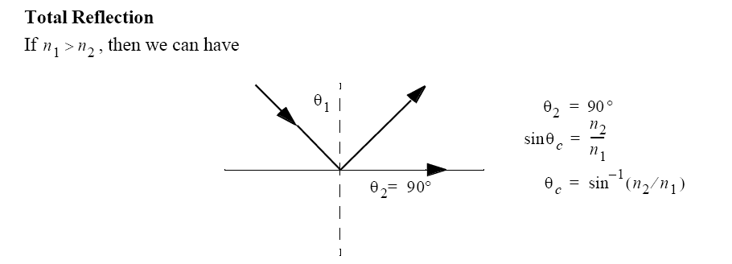

Slide 30

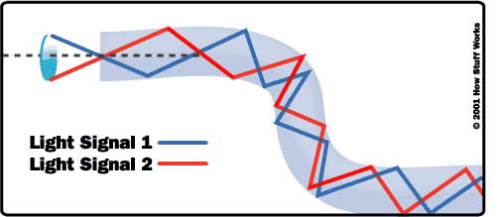

Slide 31

The minimum angle of incidence at which a light ray ay strike the interface of two media and result in an angle of refraction of 90° or greater.

Slide 32

The maximum angle in which external light rays may strike the air/glass interface and still propagate down the fiber.

Slide 33
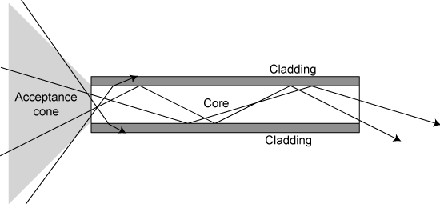

Slide 34
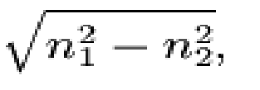
θin (max) = sin-1
Where,
θin (max) – acceptance angle (degrees)
n1 – refractive index of glass fiber core (1.5)
n2 – refractive index of quartz fiber cladding
( 1.46 )

Slide 35
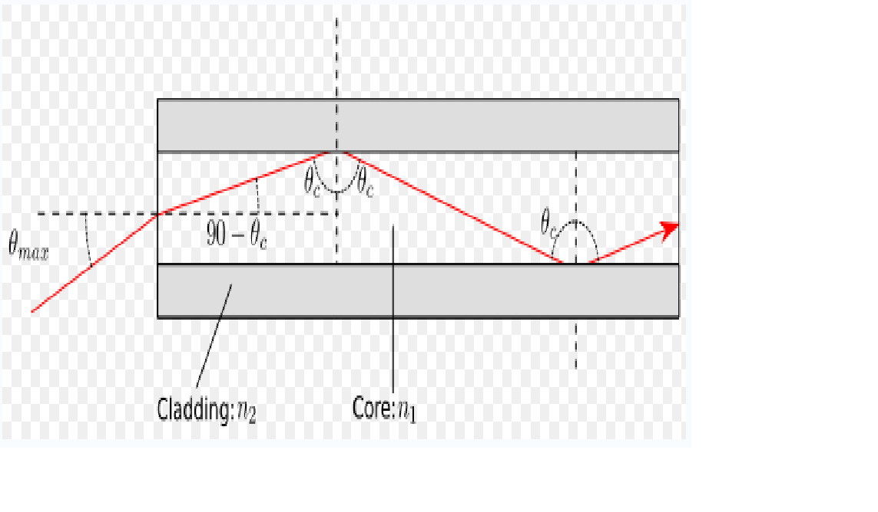

Slide 36
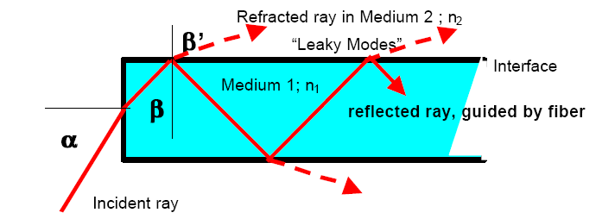

Slide 37
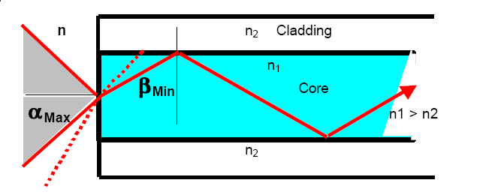

Slide 38
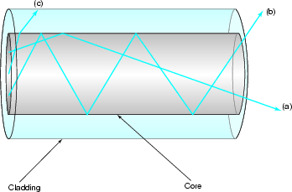
Core and cladding with different indices of refraction
Core-cladding boundary

Slide 39

Used to describe the light-gathering or light-collecting ability of an optical fiber.
In optics, the numerical aperture (NA) of an optical system is a dimensionless number that characterizes the range of angles over which the system can accept or emit light

Slide 40

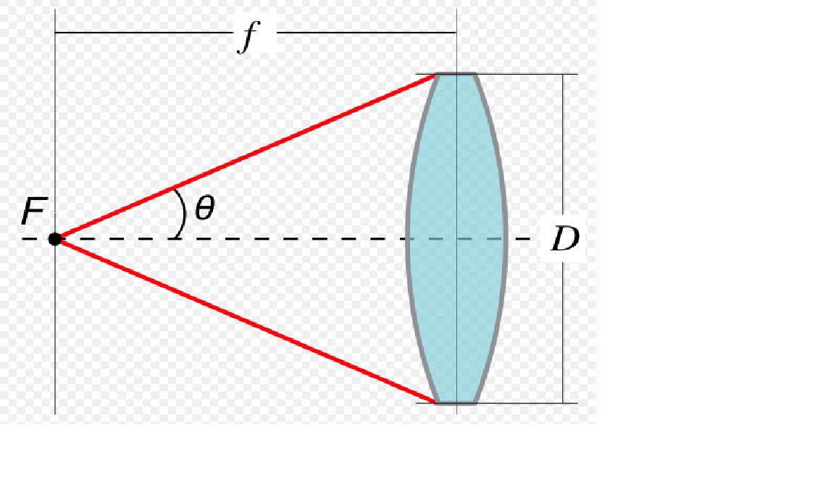
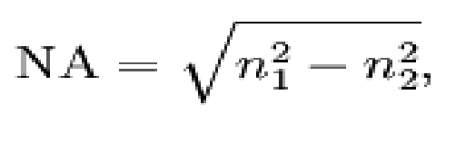
The numerical aperture in respect to a point P depends on the half-angle θ of the maximum cone of light that can enter or exit the lens.

Slide 41
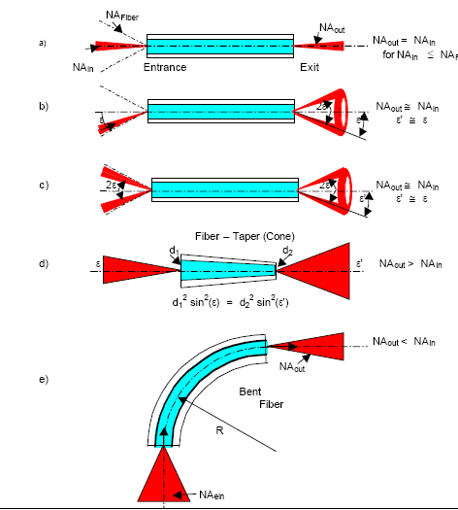

Slide 42


Two main categories of optical fiber used in fiber optic communications are multi-mode optical fiber and single-mode optical fiber.

Slide 43

Single-mode fibers – used to transmit one signal per fiber (used in telephone and cable TV). They have small cores(9 microns in diameter) and transmit infra-red light from laser.

Slide 44

Single-mode fiber’s smaller core (<10 micrometres) necessitates more expensive components and interconnection methods, but allows much longer, higher-performance links.

Slide 45

Multi-mode fibers – used to transmit many signals per fiber (used in computer networks). They have larger cores(62.5 microns in diameter) and transmit infra-red light from LED.

Slide 46


Multimode fiber has a larger core (≥ 50 micrometres), allowing less precise, cheaper transmitters and receivers to connect to it as well as cheaper connectors.

Slide 47
However, multi-mode fiber introduces multimode distortion which often limits the bandwidth and length of the link. Furthermore, because of its higher dopant content, multimode fiber is usually more expensive and exhibits higher attenuation.

Slide 48

The index profile of an optical fiber is a graphical representation of the magnitude of the refractive index across the fiber.
The refractive index is plotted on the horizontal axis, and the radial distance from the core axis is plotted on the vertical axis.

Slide 49


The boundary between the core and cladding may either be abrupt, in step-index fiber, or gradual, in graded-index fiber.

Slide 50

A step-index fiber has a central core with a uniform refractive index. An outside cladding that also has a uniform refractive index surrounds the core;
however, the refractive index of the cladding is less than that of the central core.

Slide 51

In graded-index fiber, the index of refraction in the core decreases continuously between the axis and the cladding. This causes light rays to bend smoothly as they approach the cladding, rather than reflecting abruptly from the core-cladding boundary.

Slide 52
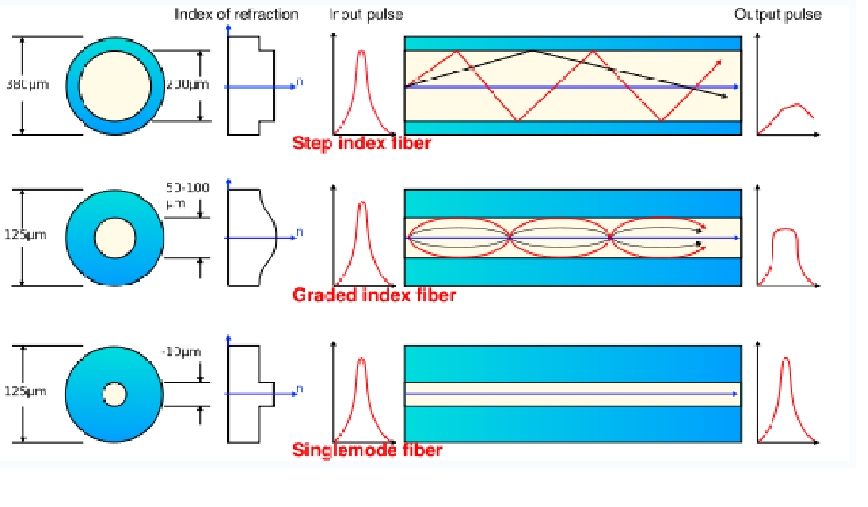

Slide 53

multimode step-index fiber
  the reflective walls of the fiber move the light pulses to the receiver
multimode graded-index fiber
  acts to refract the light toward the center of the fiber by variations in the density
single mode fiber
  the light is guided down the center of an extremely narrow core

Slide 54
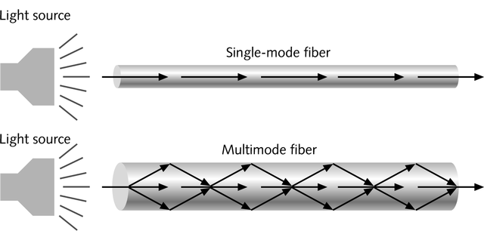
Single-mode fiber
  Carries light pulses along single path
Multimode fiber
  Many pulses of light generated by LED travel at different angles

Slide 55

fiber optic multimode
step-index
fiber optic multimode
graded-index
fiber optic single mode

Slide 56
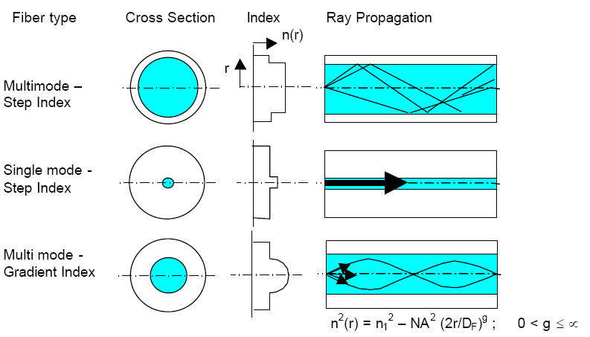

Slide 57


light-emitting diodes (LEDs)
laser diodes

Slide 58

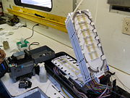
LEDs produce incoherent light
laser diodes produce coherent light.

Slide 59


LED is a forward-biased p-n junction, emitting light through spontaneous emission, a phenomenon referred to as electroluminescence.
The emitted light is incoherent with a relatively wide spectral width of 30-60 nm.

Slide 60
LED light transmission is also inefficient, with only about 1 % of input power, or about 100 microwatts, eventually converted into «launched power» which has been coupled into the optical fiber.
However, due to their relatively simple design, LEDs are very useful for low-cost applications.

Slide 61
Communications LEDs are most commonly made from gallium arsenide phosphide (GaAsP) or gallium arsenide (GaAs)
Because GaAsP LEDs operate at a longer wavelength than GaAs LEDs (1.3 micrometers vs. 0.81-0.87 micrometers), their output spectrum is wider by a factor of about 1.7.

Slide 62

LEDs are suitable primarily for local-area-network applications with bit rates of 10-100 Mbit/s and transmission distances of a few kilometers.
LEDs have also been developed that use several quantum wells to emit light at different wavelengths over a broad spectrum, and are currently in use for local-area WDM networks.

Slide 63

A semiconductor laser emits light through stimulated emission rather than spontaneous emission, which results in high output power (~100 mW) as well as other benefits related to the nature of coherent light.

Slide 64
The output of a laser is relatively directional, allowing high coupling efficiency (~50 %) into single-mode fiber. The narrow spectral width also allows for high bit rates since it reduces the effect of chromatic dispersion. Furthermore, semiconductor lasers can be modulated directly at high frequencies because of short recombination time.

Slide 65
Laser diodes are often directly modulated, that is the light output is controlled by a current applied directly to the device.

Slide 66

The main component of an optical receiver is a photodetector that converts light into electricity through the photoelectric effect.

Slide 67
The photodetector is typically a semiconductor-based photodiode, such as a p-n photodiode, a p-i-n photodiode, or an avalanche photodiode.

Slide 68
Metal-semiconductor-metal (MSM) photodetectors are also used due to their suitability for circuit integration in regenerators and wavelength-division multiplexers.

Slide 69
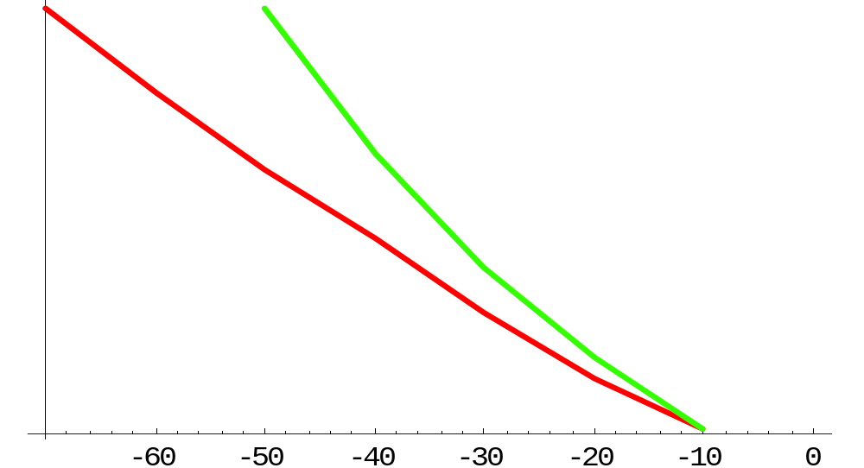
10⁻¹
10⁻⁵
10⁻⁹
10⁻¹³
10⁻¹⁷
PIN
APD
Bit Error Rate
Average Received Optical Power (dBm)

Slide 70

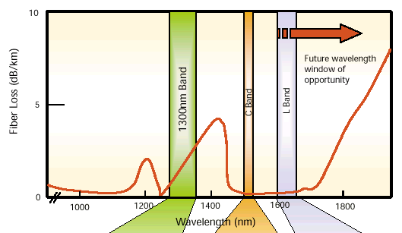
Notes:
Polarizers, Retarders, and Depolarizers

Slide 71

Band | Description | Wavelength Range
O band | original | 1260 to 1360 nm
E band | extended | 1360 to 1460 nm
S band | short wavelengths | 1460 to 1530 nm
C band | conventional ("erbium window") | 1530 to 1565 nm
L band | long wavelengths | 1565 to 1625 nm
U band | Ultra-long wavelengths | 1625 to 1675 nm

Slide 72

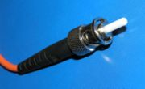
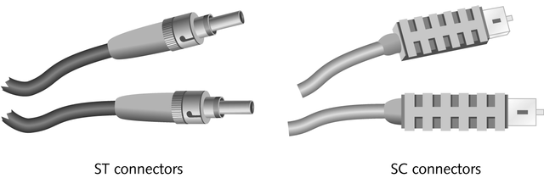
Two popular connectors used with fiber-optic cable:
  ST connectors
  SC connectors

Slide 73
Long Haul Fiber System Overview
Types of Systems
Pulse quality
Bit Error Rate
Noise
Metro
CATV
Long Haul
Access
Metro
Metro
Submarine networks
OPT 471A © Russell A. Chipman
Notes:
Polarizers, Retarders, and Depolarizers

Slide 74

